Slide 1


UAE Economy at a Glance

Slide 2
Presentation Outline
UAE Economy
UAE Investment Environment
UAE Global Business Rankings

Slide 3
UAE Economy

Slide 4
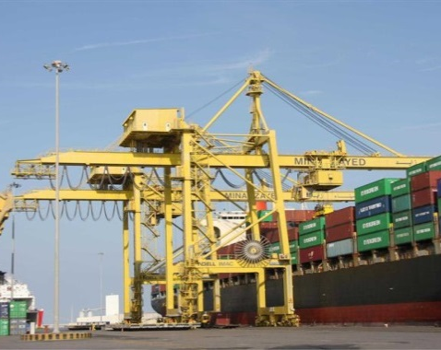
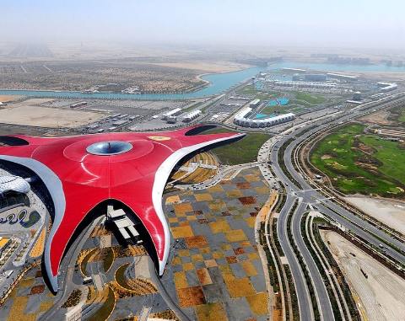
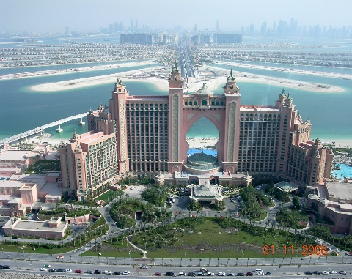
UAE Economy
The UAE Economic Indicators
Real GDP & Diversification
UAE GDP Growth
(2018)
volume 398 Billion US Dollars
UAE GDP Growth
(2019 Preliminary)
volume 405 Billion US Dollars
Diversification of
the GDP 2019
GDP
GDP
1.7%
Oil
30%
1.2%
Non oil GDP
0.7%
1.0%
Non-oil
70%
Non oil GDP
4

Slide 5
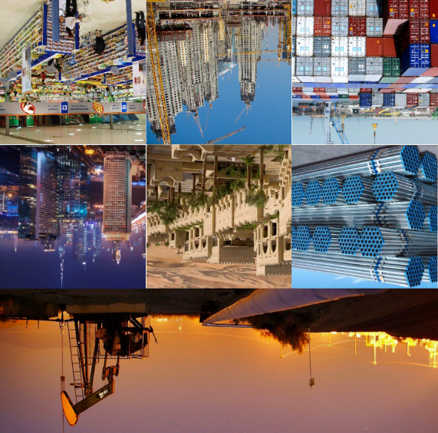
UAE Economy
By Economic Activities, 2019
Percentage Distribution of GDP Constant Price 2010
29.8%
12.5%
8.4%
8.3%
8.0%
5.7%
5.4%
5.2%
2.9%
2.9%
2.6%
2.3%
1.7%
4.2%
Mining and Quarrying (includes crude oil and natural gas)
Wholesale and Retail Trade; Repair of Motor Vehicles and Motorcycles
Manufacturing
Construction
Financial and insurance activities
Transportation and Storage
Real Estate Activities
Public Administration and Defence; Compulsory Social Security
Electricity, gas, and Water Supply; Waste Management Activities
Information and Communication
Professional, Scientific and Technical Activities
Accommodation and Food Service Activities
Administrative and Support Service Activities
Other Sectors
5

Slide 6
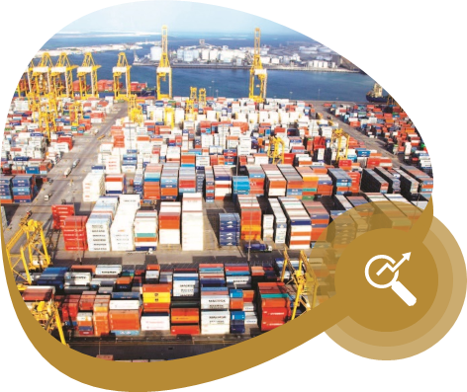


UAE Economy
Percentage & Volume of Non-Oil Trading Partners, 2019
Including Free Zones & Warehouse (Billions USD)
China 10.8%
50.1
India 8.9%
Kuwait 2.3%
41.4
10.6
Germany 2.6%
12.2
Saudi Arabia 6.6%
Oman 2.8%
13.1
30.8
Japan 3.2%
USA 5.7%
14.6
26.3
Iraq 3.3%
Switzerland 3.8%
6
17.8
15.1

Slide 7
UAE Innovation Strategy
In 2015, the UAE released its National Innovation Strategy which prioritized 7 key sectors:
Renewable energy
Transport
Education
Health
Technology
Water
Space

Slide 8
UAE Investment Environment

Slide 9
UAE Global Ranking in the FDI Inflows and Outflows, 2018-2019
Inflows of Inward Investments
Outflow of Foreign Investment
27
24
19
19
Globally
Globally
Globally
Globally
2018
2019
2018
2019
2019
32.7%
2019
5.6 %
USD 13.787 Billion
USD 15.9 Billion
2018
USD 10.385 Billion
2018
USD 15.06 Billion
9
UNCTAD, World Investment Report 2020

Slide 10










UAE FDI Strategy
Top 10 Countries in the Flow of Foreign Direct Investment Globally 2019
Middle East and North Africa Region
West Asian Region

Slide 11
UAE Investment Environment
The UAE’s investment environment is marked by stability, modern infrastructure, effective economic policy, and modern economic legislations.
UAE enjoys domestic political stability and healthy international relations with the world.
Strategic trade hub, offering access to regional markets.
Free transfer of profits, revenues and assets.
Efficient legal and courts systems.
Laws to protect foreign capital (Such as IPR , competition).
Free Zones options are available.
11

Slide 12
UAE Investment Environment
Ambitious legislative reforms to ensure efficiency, transparency, and investor confidence.
Low customs tariffs between 0 and 5 percent for almost all goods.
No income tax.
World class infrastructure.
Efficient Government (the “Smart Government” initiative).
Global aviation hub.
Sophisticated lifestyle which made UAE the favorable destination for more than 200 nationalities.

Slide 13

UAE Investment Environment
Golden Visa
In 2019, the UAE implemented a new system for long-term residence visas. The new system enables foreigners to live, work and study in the UAE without the need of a national sponsor and with 100 per cent ownership of their business on the UAE’s mainland. These visas will be issued for 5 or 10 years and will be renewed automatically.
The following categories are entitled to apply for a 10-year residence visa in the UAE.
Investors in public investments
Persons with specialized talents
13

Slide 14






UAE Investment Environment
UAE Bilateral Agreements
UAE has signed bilateral preferential agreements with some Arab Countries (Syria, Jordan, Lebanon, Morocco and Iraq).
According to these agreements, the UAE and its partners accord each other preferential access for a specified list of goods.
78
Agreements related to encouragement and protection of investment .
Agreement
At the end of 2019 UAE signed.
115
Agreements on avoidance of double taxation with different countries.
Agreement

Slide 15
UAE Investment Environment
The Prominent Features and Incentives Granted to Foreign Investors on the Amendments of the UAE Federal Law No. (2) Of 2015 on Commercial Companies
Full ownership of all economic sectors with the exception of strategic impact activities.
Full ownership of all legal forms of companies.
Possibility of ownership in sectors with a strategic impact under certain legislations.
Practicing banking and insurance businesses in all legal forms for companies.
No obligations for a limited liability company to be with the name of its owner.

Slide 16
UAE Investment Environment
The Prominent Features and Incentives Granted to Foreign Investors on the Amendments of the UAE Federal Law No. (2) Of 2015 on Commercial Companies
Absence of the need of a local service agent.
Freedom of settling disputes.
Absence of minimum capital requirement for limited liability companies.
Possibility of Calling a General Assembly Meeting if requested by partners holding 10% of the LLC's capital.
Extending the Period of Announcing the Invitation to the general assembly to 21 days before instead of 15 days for the LLC Company.

Slide 17
UAE Investment Environment
The Prominent Features and Incentives Granted to Foreign Investors on the Amendments of the UAE Federal Law No. (2) Of 2015 on Commercial Companies
Holding General Assembly Meetings remotely for the LLC company.
The Legal Quorum for the Assembly Meeting of the LLC Company 50% instead of 75% of the Capital Shares.
Possibility of an urgent Judgment from the Court to Save the LLC from Liquidation.
Possibility for any Increase in the Issued Capital of the Public Shareholding Company within 3 Years.
Flexibility in Capital Reduction Requirements for the Public Joint-Stock Company.

Slide 18
UAE Investment Environment
The Prominent Features and Incentives Granted to Foreign Investors on the Amendments of the UAE Federal Law No. (2) Of 2015 on Commercial Companies
Controlling the entire Membership of the Boards of Directors of Public Joint-Stock Companies.
Allow all Members of the Board of Directors of the Public Shareholding Company to be Non-Shareholders.
Absence of Requirement the Approval of the Securities and Commodities Authority to Amend the Memorandum of Association or Articles of Association of the Public Shareholding Company.
Allowing Financial Institutions to Provide Loans to Board Members.
Possibility of Calling a General Assembly Meeting if requested by partners holding 10% of the Public Joint-Stock Company.

Slide 19
UAE Investment Environment
The Prominent Features and Incentives Granted to Foreign Investors on the Amendments of the UAE Federal Law No. (2) Of 2015 on Commercial Companies
There is no Limit for the Number of Shareholders in the Private Joint Stock Company.
Restructuring the Company in Light of Accumulated Losses.
Granting the Investor any of the Following Actions:
The introduction of a partner or a number of partners.
Transfer of company ownership.
Changing the legal form of the company.
Mergers and acquisition.
Liquidation.

Slide 20
UAE Global Business Rankings

Slide 21

UAE Global & Regional Business Rankings
UAE Ranking in Ease of Doing Business
UAE Ranking in Economic Freedom
(World Bank) 2020
(The Heritage Foundation) 2020
16
18
1st
Ease of Access to Electricity
3rd
Building Permits Index
9th
Contract Enforcement Index
10th
Property Registration Index
Globally
Globally

Slide 22

UAE Global & Regional Business Rankings
IMD World Competitiveness Ranking - 2020
IMD World Digital Competitiveness Ranking 2019
9
3rd
14
1st
Public-private partnerships
Government Efficiency
International experience
4th
Economic Performance
Agility of companies
7th
Use of big data and analytics
Business Efficiency
3rd
Management of cities
Globally
Globally

Slide 23
UAE Global & Regional Business Rankings
UAE Ranking in Global Competitiveness Index (WEF) in 2019
25
1st
Macroeconomic stability index.
Electricity rate indicator.
Mobile phone index / 100.
Debt dynamics index.
Annual inflation percentage indicator.
3rd
Government’s Efficiency in Responding to Change
2nd
Information and Communications Technology Accreditation Index.
Mobile Cellular Subscriptions Index.
Population Conductivity Index,%.
Workforce diversity index.
Globally
23

Slide 24
UAE Global & Regional Business Rankings
UAE Ranking in World Trade Report (WTO) – April 2020
World Trade Organization
20th
23rd
In Commodity Exports
In Service Exports
20th
21st
In Service Imports
In Commodity Imports

Slide 25
Thank You

